Slide 1
Various flood-related services available from the Borough
Flood mapping
LOMA application services
Advocate for property owner

Slide 2
Flood Mapping Services
Wondering what flood zone a property in the Borough of Manville falls within?
Contact Andrea Bierwirth @ abierwirth@manvillenj.org with the address of the property. A current map will be emailed to you.

Slide 3
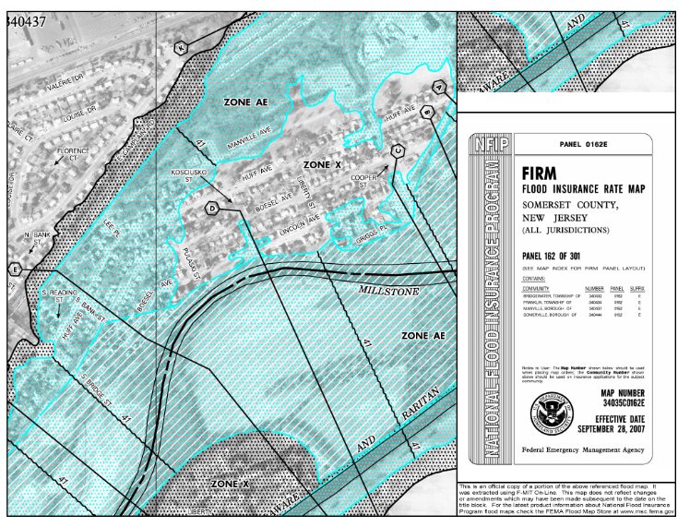

Slide 4
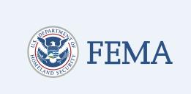
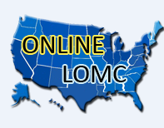
What is a LOMA?
A Letter of Map Amendment (LOMA)
An official revision to a FEMA map performed by describing the property affected. LOMA’s are generally issued when properties have been inadvertently included in the floodplain.

Slide 5
Why a LOMA?
Bank tells property owner they need flood insurance after not needing insurance previously (flood mapping issue).
Challenge the flood zone designation and provide documentation to get the requirement waived if you think your home was mistakenly placed in the flood plain.
Only one authority has enough clout to tell the bank that the property is outside the 100 year floodplain – FEMA

Slide 6
What Documents are Needed?
Deed of Property
Survey or Plat
Tax Map of Property
Elevation Certificate
Date of Construction
Firmette
abierwirth@manvillenj.org

Slide 7

Flood Insurance Advocate Office
Available to the public
Staffed with NFIP experts
Flood hazard mapping experts
https://www.fema.gov/webform/flood-insurance-advocate-ask-question

